Slide 1
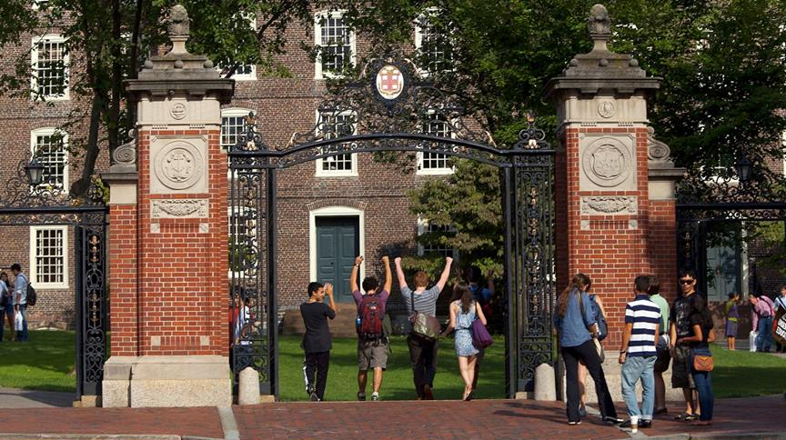
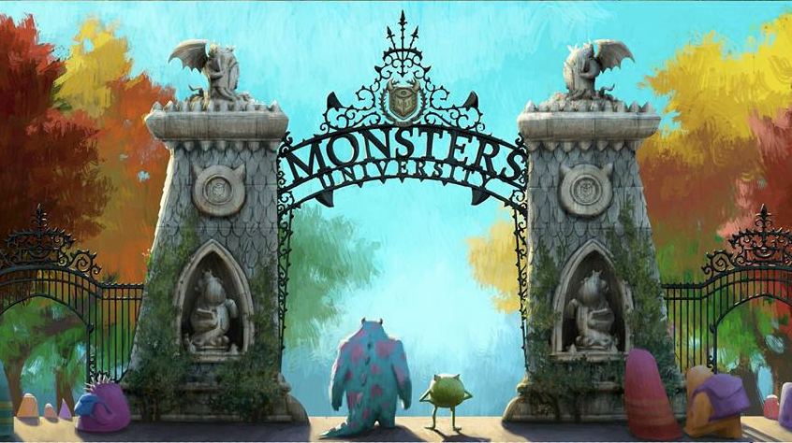
CSCI 0150
(also known as CS15)
A Gateway to Computer Science
Monsters University, Pixar 2016 ©

Slide 2
Computer Science (1/2)
CS15 is a start to understanding computer science
for your own intellectual interest
for its enrichment of other fields
for its combination of scientific, engineering, art and design concepts and practices, and as a “mode of thought” – “computational thinking”

Slide 3
Computer Science (2/2)
IT, or information technology, including CS, is key to the “knowledge economy”
Omnipresent in a breadth of various applications and fields

Slide 4
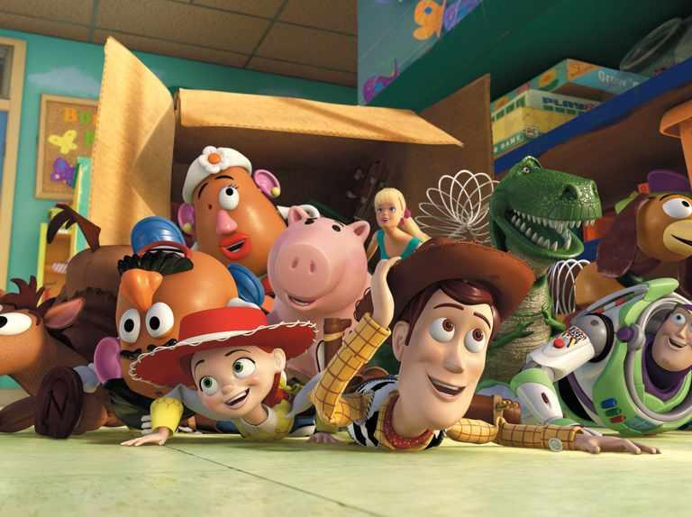
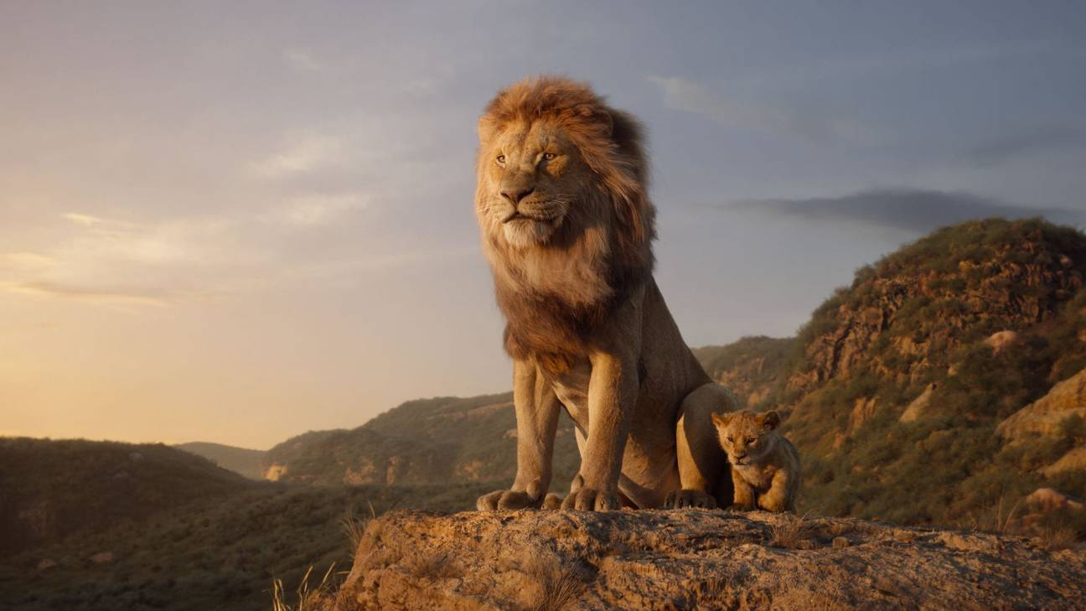
Stunning Special Effects
Pixar’s “Toy Story 4”
Disney’s ”The Lion King”
Notes:
Disney’s The Lion King © 2019 https://www.rollingstone.com/wp-content/uploads/2019/07/lion-king-review.jpg?resize=900,600&w=440
Pixar’s Toy Story 4 ©2019 https://thumbor.forbes.com/thumbor/1280x868/https%3A%2F%2Fblogs-images.forbes.com%2Fmaddieberg%2Ffiles%2F2017%2F08%2Ftoystory.jpg

Slide 5
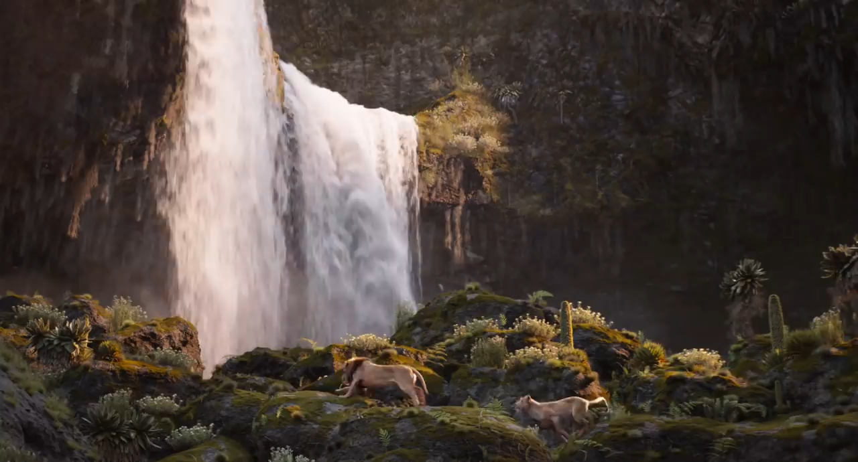

Slide 6
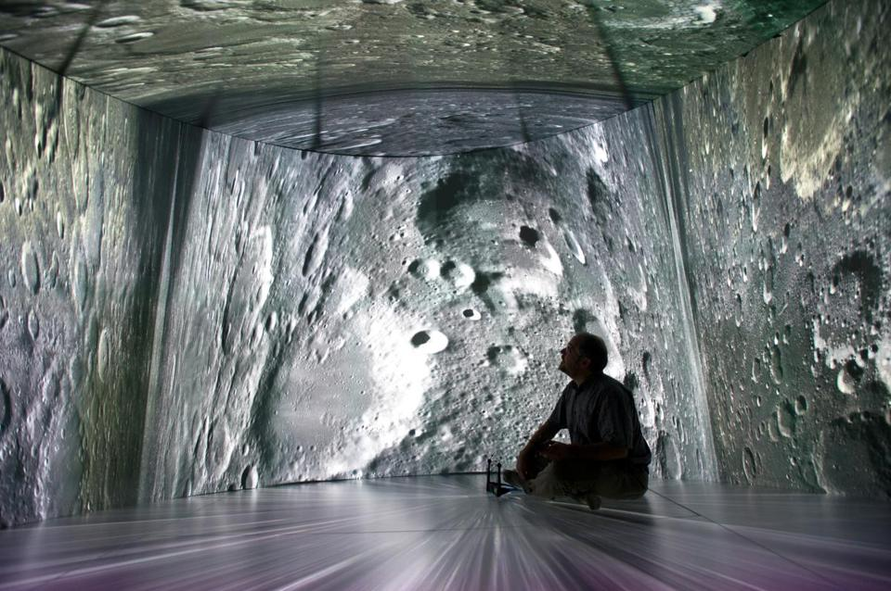
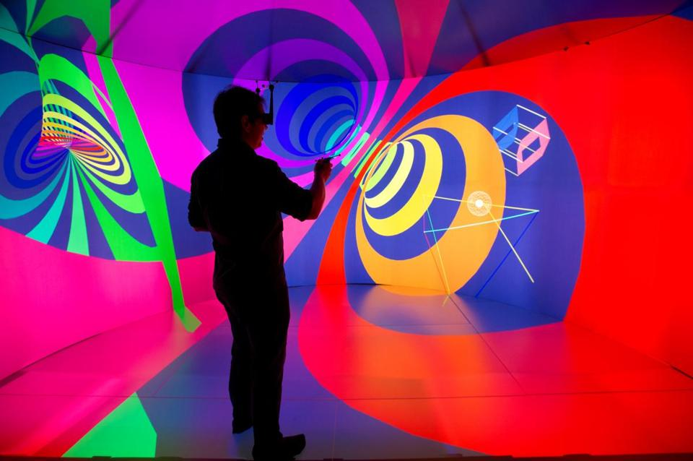
Immersive Virtual Reality
Researchers can create fully immersive 3D environments via head-tracked stereo glasses, enabling realistic “field geology” on Mars!
A state-of-the-art “Cave,” the YURT (YURT Ultimate Reality Theater), at 180 George Street
much higher quality (e.g., 100Mpixels) and much more comfortable than Oculus Rift, VALVE Vive and other VR headsets
but way more expensive!

Slide 7
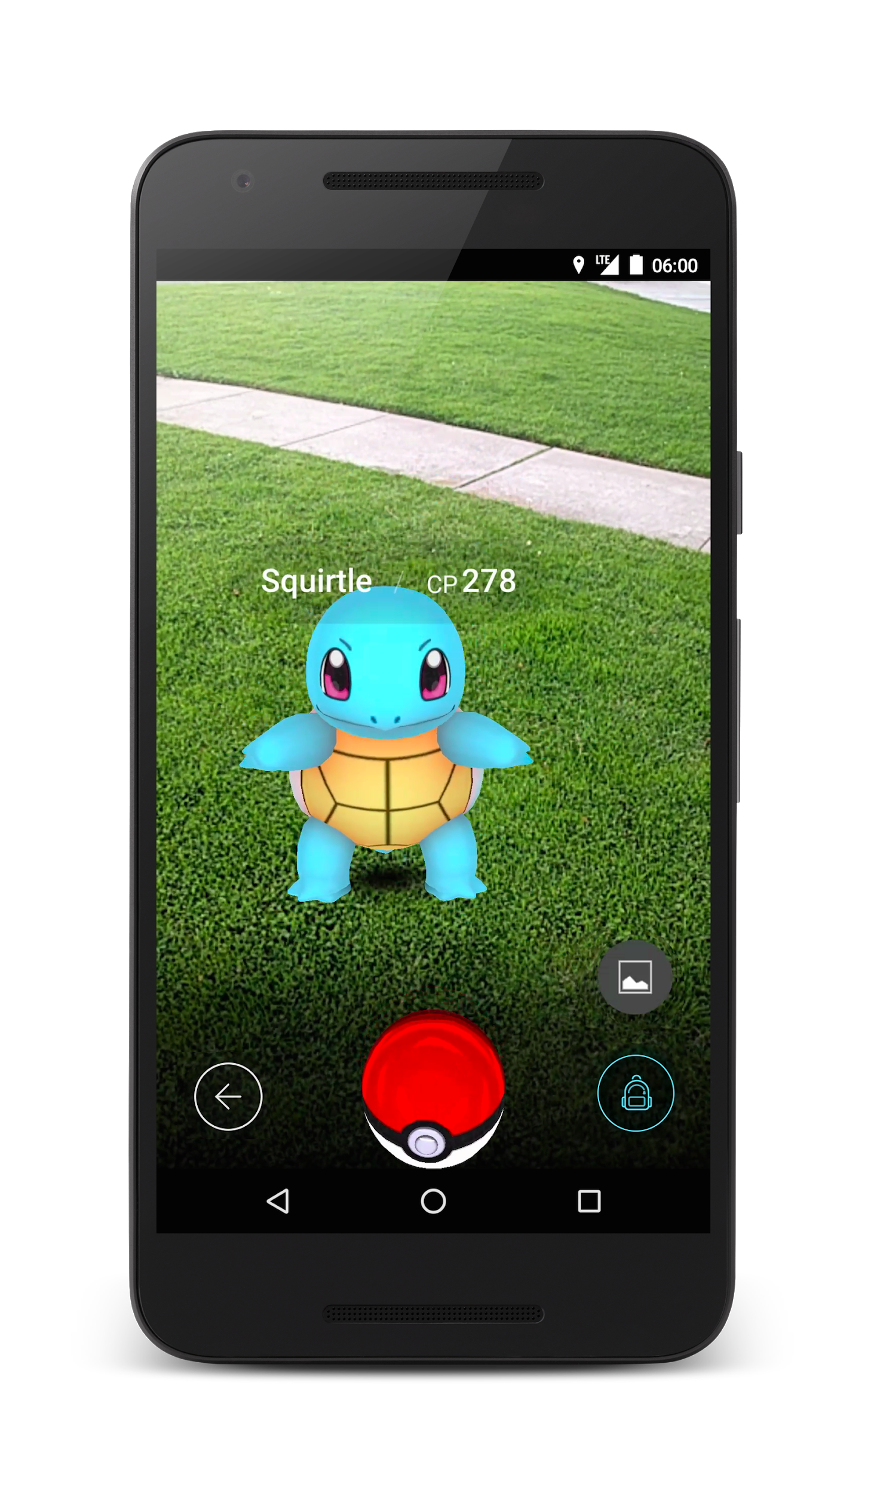
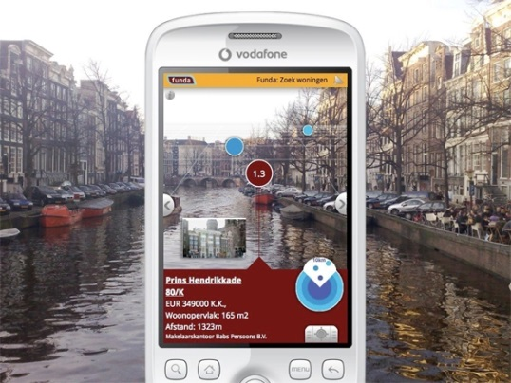
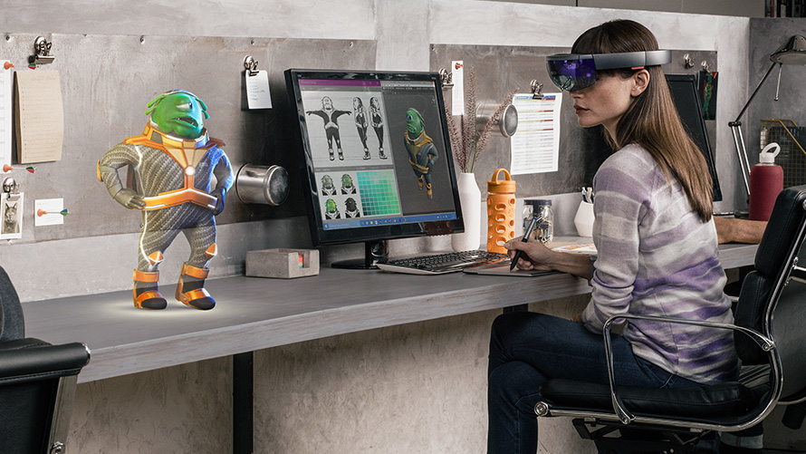
Augmented Reality
Creates virtual elements “on top of” the real world, blending a digital reality with an existing one!
Smartphone apps, e.g., Pokémon Go
Microsoft HoloLens
special glasses with built-in head tracker that create a mixed reality
still in development

Slide 8
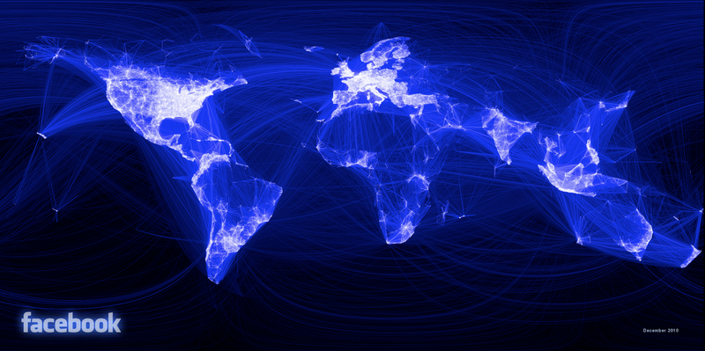
The Internet and Social Networks
Facebook, Inc. – July 2019
2.7 billion active users worldwide
83 million fake profiles
510,000 comments are posted, 293,000 statuses are updated, and 136,000 photos are uploaded every minute
300 million photo uploads per day
Notes:
https://zephoria.com/top-15-valuable-facebook-statistics/

Slide 9
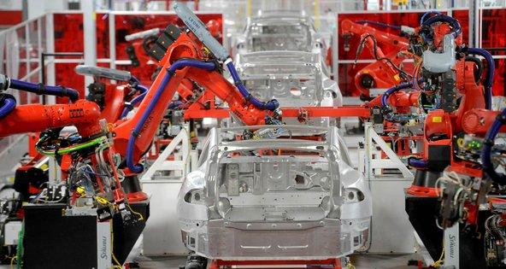
Opportunities/Threats of the Digital Age (1/4)
Machines continue to replace human labor and decision-making
machines have increased human productivity while reducing demand for routine, repetitive jobs
as middle-skilled, task-intensive jobs disappear, income gap (“income inequality”) widens
but new jobs are being created, old jobs “upskilled” to be more interesting
impacting not just blue collar jobs such as factory work or driving, x-ray reading, tax advising, news reporting…
Education is key to economic survival
Should there be a ”robot tax”?
Should there be a “guaranteed minimum income,” also called Universal Basic Income?
“What is the future of work?”

Slide 10
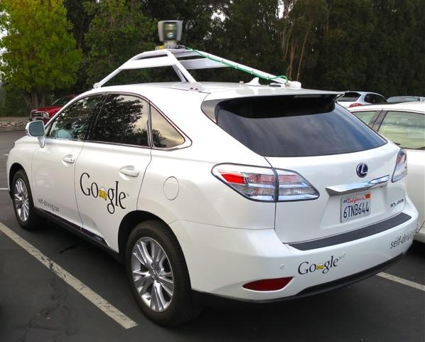
Opportunities/Threats of the Digital Age (2/4)
Dangers of yielding too much control to algorithms, some too complex to be understood by most people
instability in the stock market due to trading algorithms
autonomous vehicles (autopilot on planes, driverless cars…)
nuclear power plants and other infrastructure
“bias” in algorithms (mortgage lending, job placement…)
Cyberfraud, Cybercrime, Cyberwarfare
Facebook-Cambridge Analytica data scandal
hacking of our democratic machinery (DNC, voting data…)
we keep experiencing huge data breaches (Equifax…)
offense has the advantage over defense
schools in Russia, China, North Korea (at least) teach hacking… we’re well beyond amateur hacking
will the next war be fought by drones, and how can they be controlled?
Brown is strong in cybersecurity technology and policy

Slide 11
Privacy and Security
Mathematics
Algorithms
Crypto
Systems
Politics
Law

Slide 12
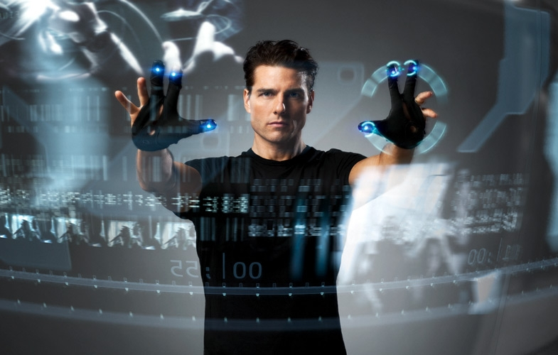
Opportunities/Threats of the Digital Age (3/4)
Big Data
“data mining,” “machine learning,” “deep learning”, “reinforcement learning”…
statistics-based algorithms for detecting patterns, anomalies, etc.
search
real-time language translation
face recognition
can identify faces in crowd photos
gesture recognition for user interfaces
credit card fraud detection
crime and terrorism anticipation
but what about privacy in the age of the “surveillance state”?!?
Spielberg’s “Minority Report” (2002) with Tom Cruise

Slide 13

Opportunities/Threats of the Digital Age (4/4)
Big data & personal privacy
information now more accessible than ever
threat to privacy represented by increasing storage of personally identifiable information – is there any real “anonymous data”?!?
Google search results and posting information influencing voter decision-making
do hosting companies have the right/duty to ban offensive websites (e.g., Alex Jones, Louis Farrakhan)
NSA/Snowden Controversy; what about Google, Facebook, Microsoft and their data collection and use of that data – digital stuff is permanent, and you have no control over how it is used (Sun’s Scott McNealy – “privacy is dead, get over it!”)
Need an educated government, citizenry
“Responsible CS” and Ethics TAs (ETAs)
our ETAs are: Kendrick Tan, Rebecca Zuo

Slide 14
CS: So Much More Than Programming!
Computers are our only universal machine, through the magic of software…
if you can program it, a computer can execute it
Programming is a means to an end, much like mathematics is… but they are both also fascinating topics in their own right!
Big push to learn how to “code,” but there is no “royal road” to programming or CS – it requires serious, sustained effort

Slide 15
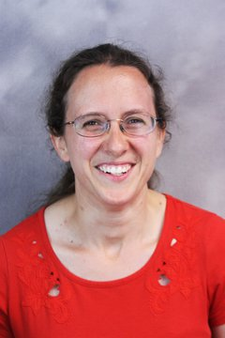
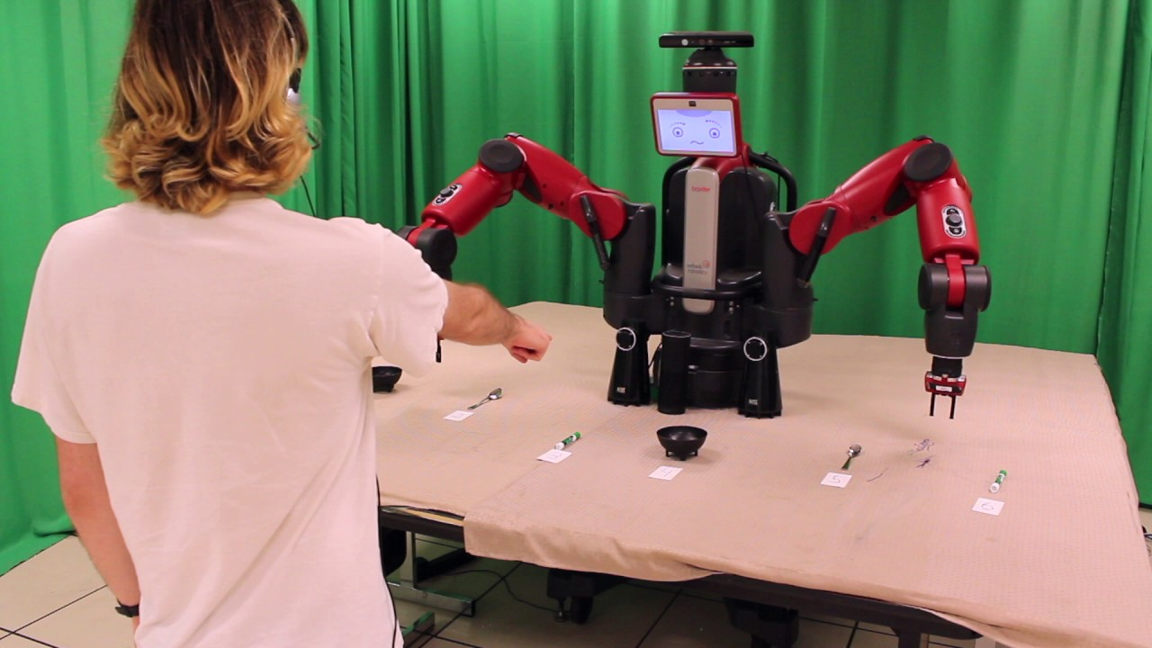
Computer Science at Brown Works on Hard Questions (1/3)
How can robots understand language to answer questions and hold conversations?
Stefanie Tellex

Slide 16

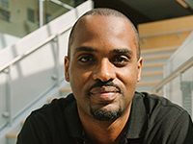
Computer Science at Brown Works on Hard Questions (2/3)
How can we use encryption to promote privacy?
How can we analyze the efficiency of algorithms we use in encryption?
Seny Kamara (CS16)

Slide 17

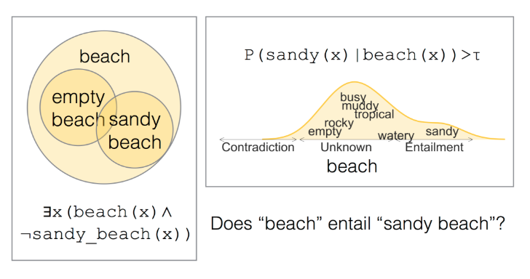
Computer Science at Brown Works on Hard Questions (3/3)
How can AI understand the intricacies of human language the way humans do?
Ellie Pavlick

Slide 18
Other Areas of Research at Brown
Algorithms and Theory (Pedro Felzenszwalb, Sorin Istrail, Philip Klein, John Savage, Roberto Tamassia, Eli Upfal)
Artificial Intelligence (Stephen Bach, Eugene Charniak, Pedro Felzenszwalb, Amy Greenwald, George Konidaris, Michael Littman, Ellie Pavlick, Stefanie Tellex)
Comp Bio (Sorin Istrail, Sohini Ramachandran, Eli Upfal)
Data Science (Ugur Cetintemel, David Laidlaw, Stan Zdonik)
Machine Learning (Stephen Bach, Eugene Charniak, Michael Littman, Daniel Ritchie, James Tompkin, Eli Upfal)
Security (Seny Kamara, Vasileios Kemerlis, Shriram Krishnamurthi, Anna Lysyanskaya, Steve Reiss, John Savage, Roberto Tamassia)
Visual Computing (Andy van Dam, Jeff Huang, David Laidlaw, Barbara Meier, Daniel Ritchie, James Tompkin)
And more…http://cs.brown.edu/research/areas.html

Slide 19
CS: So Much More Than Programming! (2/2)
Art & Design
graphics
Computational Biology
systems
(graphical) user interfaces
Computational Economics
theory
distributed and cloud computing
programming
e-books
algorithms
Computational Finance
robotics
modeling
AI
computers
Digital Humanities
Digital Storytelling
CS
Math
Engineering

Slide 20











Why Should You Study Computer Science?
For fun and intellectual excitement
Really exciting era is just beginning
CS still a young discipline, computers just starting to act intelligently
Fundamental “mode of thought”
Increasingly important component of all other fields
Plenty of enthralling and impactful jobs in established companies, start-ups, research labs, and academia

